Slide 1


Fake News Detection by Variational Autoencoder and Topic Modelling
Team 2:
Majid Feiz (Presenter)
Marjan Hosseini
3/5/2021

Slide 2
Introduction – Motivation
Growth of social media
Increased user generated content
Increased false information
Increased Loses
Crimes
It is vital to validate the information, but it is not easy…
Unknow resources or author
Fast spreading
Not all news have pictures!
1/11
Notes:
With growth of social media, people are more exposed to news with unknown sources and fake content
Spread of false information could potentially be very misleading and would impact Social, phycological, economical aspect of people life and could even lead to crimes
It is vital to validate the credibility of information, but it is not an easy task:
Unknow resources or author
Fast spreading
Absence of multimedia with spreading textual content only

Slide 3
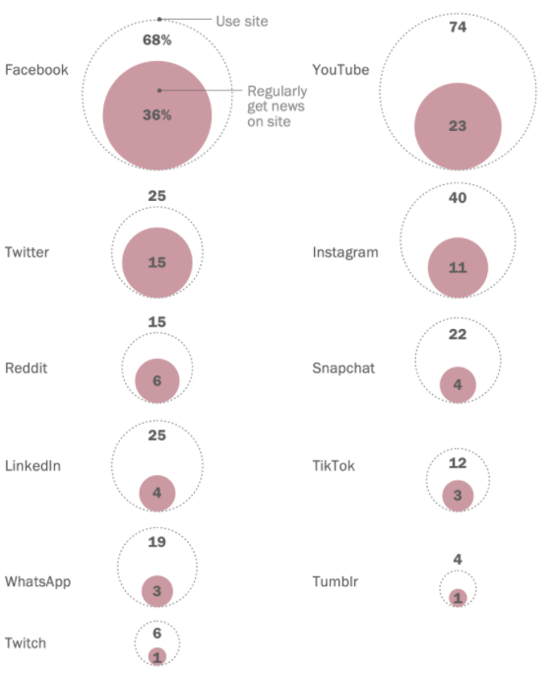
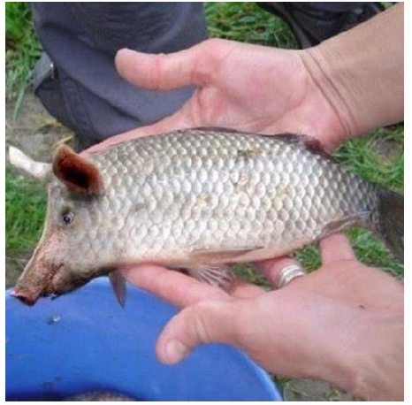
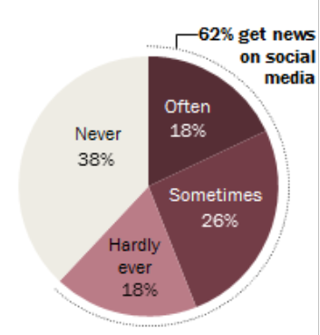
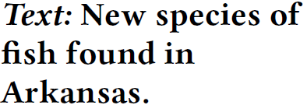
Motivation – Why it is vital?
About 6-in-10 Americans get news from social media
Facebook stands out as regular source of news for Americans
Example of fake news with both textual and visual content
[Gottfried et al. 2016]
[Khattar et al. 2019]
2/11
Notes:
It is big challenge for Facebook to detect fake news …. so it is highly demanding … know how to do it, you will have a job …. (not a bad motivation! )

Slide 4
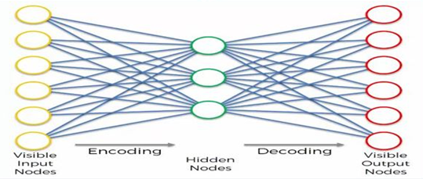
Background - Autoencoder
Latent Feature
Decoder
Encoder
To Feed the Classifier
Neural networks
Trained to reconstruct the original input
Outputs latent feature representation of input.
1
0
0
0
0
0
1
0
0
0
0
0
x
y
z
Converts the information into the reduced feature
Reduced Feature (x, y, z)
Converts it back into the original information
3/11

Slide 5
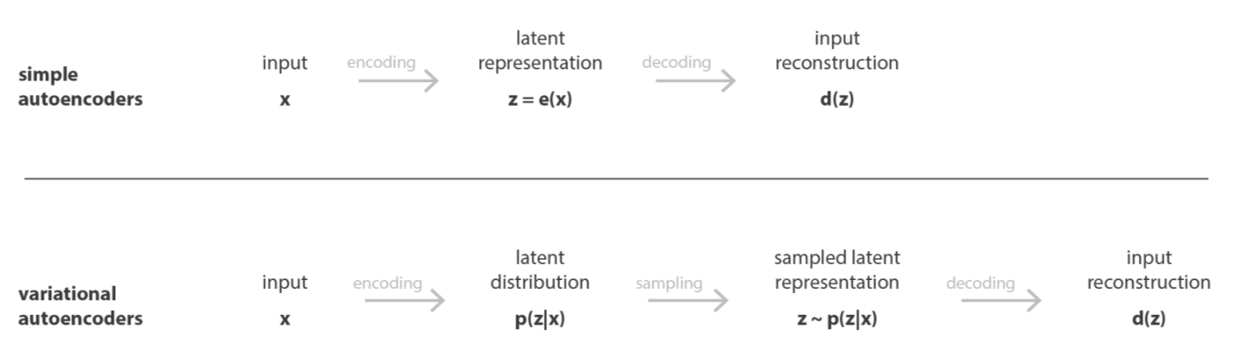

Background - Variational Autoencoder (VAE)
Latent Feature
Decoder
Encoder
Variational Autoencoder vs. Autoencoder:
To Feed the Classifier as a Probability of the outcome
deterministic
probabilistic
4/11
Notes:
Variational Autoencoder works by making the latent space more predictable, more continuous, less sparse. By forcing latent variables to become proballistics distributed, VAEs gain control over the latent space.
VAE is based on probabilistic Laten

Slide 6
Background - Latent Dirichlet Allocation (LDA)
Statistical model
Clustering method
Captures higher level information across all the documents.​
[Blei et al. 2003]
5/11
Notes:
Latent Dirichlet allocation or LDA is a statistical model for clustering the words into topics and inferring higher level information across all the documents which are actually the topics.
For example in this picture, this document we can find the percentage of each topic (X% belong to yellow, Y% belong to green etc).
It is more likley the word gene is belonging to the yellow topic because its probability is higher (in this example is 0.84)
Each document might have different topics with different proportions
Each topic is a distribution over words.
Each word is drawn from different topics with some probability.

Slide 7
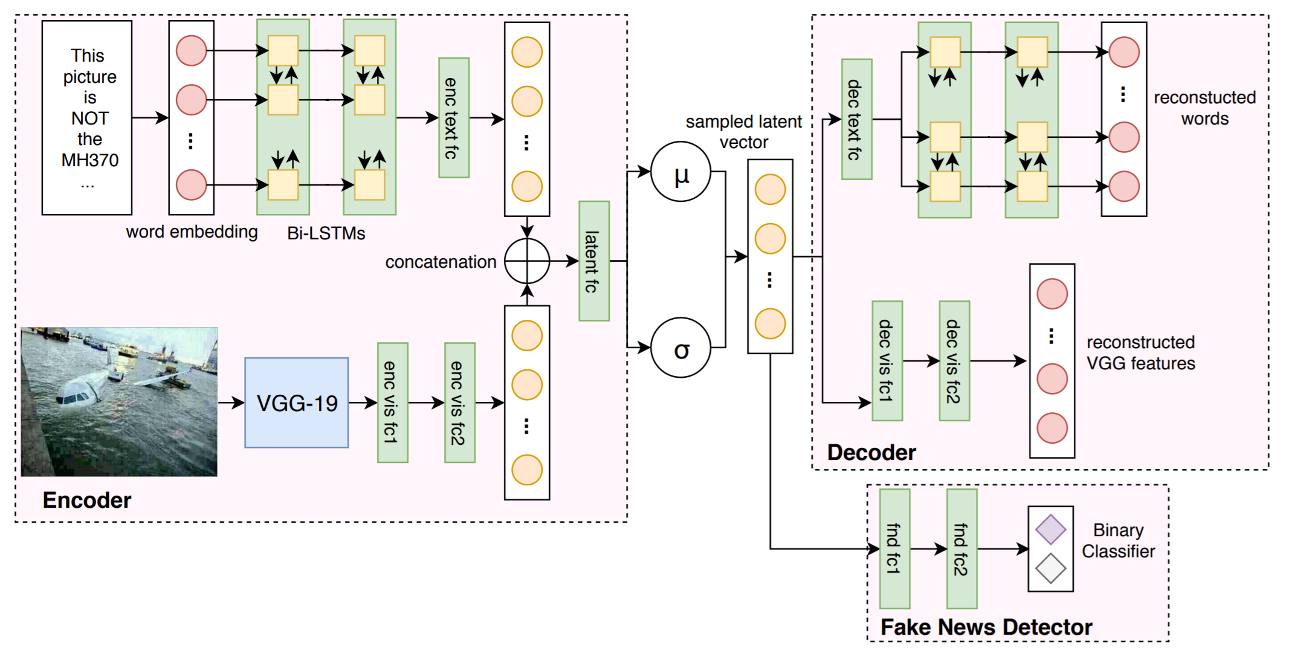
Related work
MVAE: Multimodal variational autoencoder for fake news detection
Train a VAE:
Concatenate:
Textual Content
Visual Content
Some news do not have visual content
Higher level information is not captured
[Khattar et al. 2019]
6/11

Slide 8
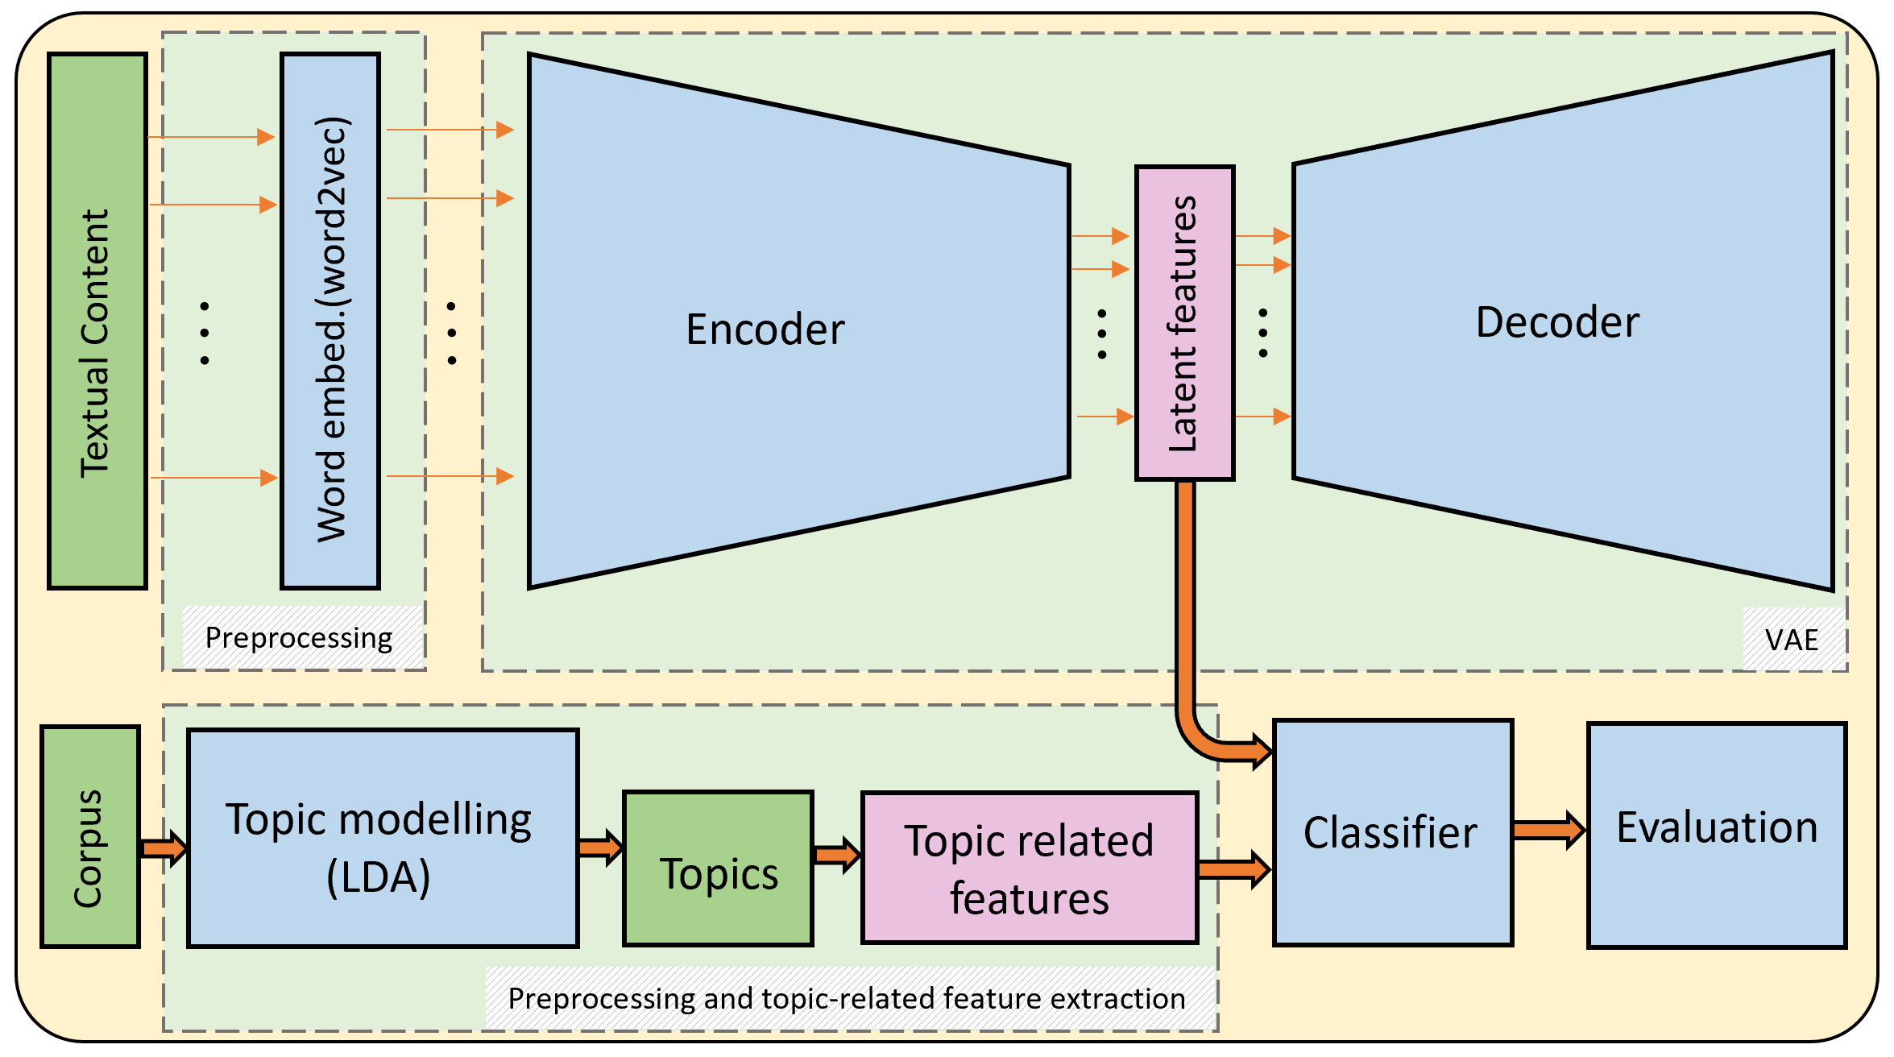
Method
Main Component:
1) Preprocessing
2) Variational Autoencoder
3) Topic Modelling (LDA)
4) Classifier
5) Evaluation
7/11
Notes:
This is a general overview of the model. In the upper part, the data is pre-processed, then the words in the news are transformed using word2vec model, and enters variational autoencoder with which we can find the latent features.
Meanwhile in the lower part, the topics are obtained using training LDA model on pre-processed data. From the topics we can extract extra features from news articles. LDA captures information hidden across all the news articles.
Then we can combine the latent and topic related features and train a classifier using both type of features.
We propose a method to detect a fake news from a textual-only content based on combining Variational Autoencoder and LDA Topic Modelling . Then train a classifier to calculate the probability of a news belong to which class (in this case fake or not fake)

Slide 9
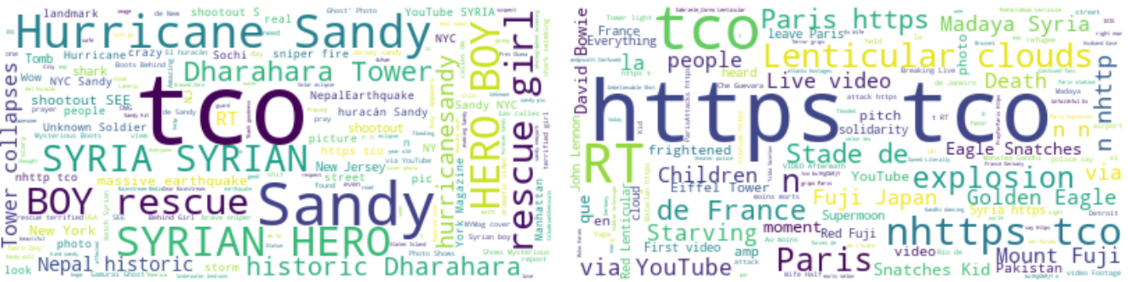
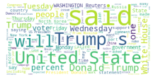
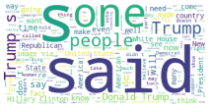
Datasets
Twitter dataset:
Published 2015
17 events
~ 17000 labeled post
Textual and visual content
ISOT dataset:
Source: Reuters.com and unreliable websites
~ 25000 labeled news
Textual content
Training set
Test set
Real news
Fake news
8/11
Notes:
You can see the word cloud representation of the data sets.

Slide 10
Contribution:
We use only textual content.
VAE captures textual content features.
LDA captures topic related features.
Increasing the interpretability of the model by LDA.
Improving the accuracy by concatenating these features.
9/11
Notes:
In this project we propose a multi-modal approach for classification of news into fake and real. Our contribution in this project is incorporating two sources of information for feature extraction. A VAE for extracting textual content and LDA model for obtaining text topics features. Our motivation for discarding visual content and other information such as source and spread pattern of the news is that not all of the datasets include associated multimedia such as image or video or other type of attributes, so here, we focus on the latent clues in the textual content. Besides, since VAE is not originally designed to capture information such as topics, we add an LDA model which also offers increased interpretability to the model. We hypothesis that concatenating latent representation produced by VAE and topic-related features together would enhance the accuracy of the model.
we intend to use only the textual data in our model because many news lack corresponding multimedia. We also believe that some higher-level information such as the topic of the text might not be properly captured using VAE, so to increase the accuracy and interpretability, we incorporate LDA [6] in our model. We infer dataset specific topics in the news and then annotate each news text according to the distribution of the topics in it. Moreover, we utilize tf-idf to filter the words that are not significant in the document.
The model is what cause news the to be real or not. (what cuase the cancer yes, or no), what cause (pattern, which feature has more corrolation) a piece of news be fake or real

Slide 11
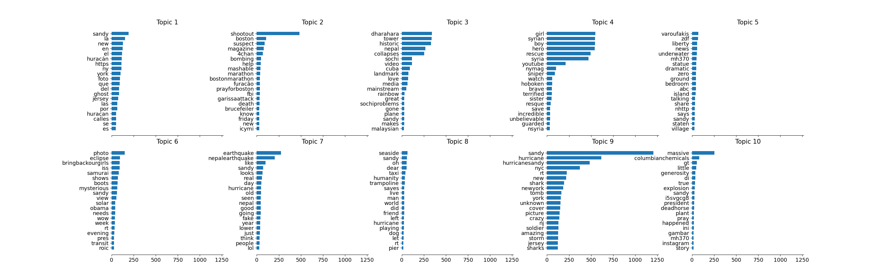
Preliminary Results
Two topics extracted from the twitter dataset:
Topic 1 most frequent words
Topic 2 most frequent words
Frequency
Frequency
10/11
Notes:
These are two interesting topics that we found in the first dataset.
We applied LDA on two datasets, one time with tfi df and one time without it. The datasets are very noisy even after preprocessing, so for finding meaningful topics, we needed to tune LDA parameters. We limit the number of features to 1000 and extracted 10 topics. Here in this plot, you can see an example of 20 most frequent words in the topics we found in dataset 1.
Two top

Slide 12
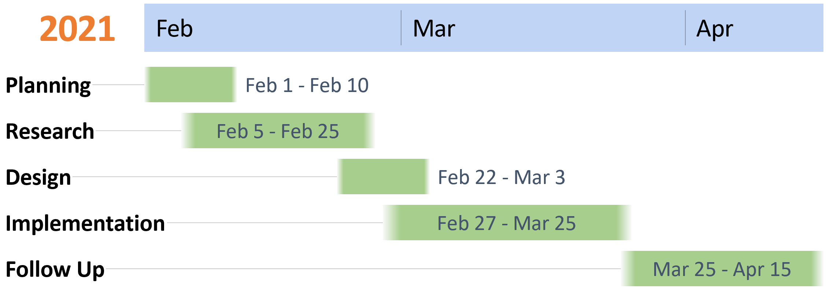
Individual Task Plan:
Implementation of VAE and LDA [Marjan]
Implementation of Classifier and Evaluation [Majid]
11/11
Notes:
We will spend most of the time on research and implementation. In follow up step, we would evaluate our model, apply necessary modifications and prepare the final report.
In terms of individual tasks in this project, Marjan is responsible for implementing the preprocessing and method and I am responsible for implementing classifier and evaluation. We both do the other tasks together.

Slide 13
Thank you! Questions?

Slide 14
BACK up slides

Slide 15
Agenda
Proposal Introduction
Motivation
Background
Method and Data
Preliminary results and Conclusion
Individual task plan
1/11

Slide 16
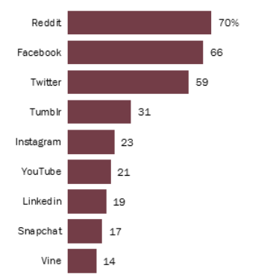
Motivation – Why it is vital?
Reddit, Facebook and Twitter users most likely to get news on each site
Facebook stands out as regular source of news for Americans
About 6-in-10 Americans get news from social media
Ref Jeffrey Gottfried and Elisa Shearer. News use across social media platforms 2016.
1/11
Notes:
It is big challenge for Facebook to detect fake news …. so it is highly demanding … know how to do it, you will have a job …. (not a bad motivation! )

Slide 17
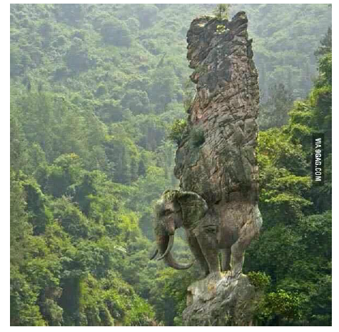
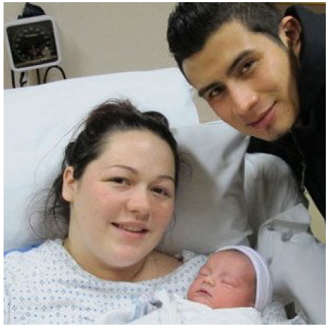
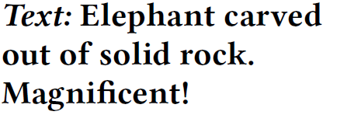
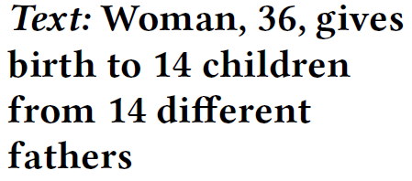
Motivation – Fake news is misleading
Not all news have multimedia
Our method uses only textual information
1/11
Notes:
Why it is an interesting and important problem
Tell a story
Add good pictures
But before get to the detail of our approach, lets review some background

Slide 18
Datasets
1) Twitter : MediaEval Workshop 2016 and is publicly available:
- 17000 posts and covers17 events
- It comes with a separate training and test set with fake/real labels
Training
Test Sets
5/11
Notes:
You can see the word cloud represention of the data sets.

Slide 19
Datasets
2) ISOT fake news dataset:
- Contains more than 25000 labeled news
- Mix of Reuters.com and unreliable websites (flagged by Politifact)
- Majority of the data are political news collected from 2016 to 2017.
Text with real
Fake lables
5/11

Slide 20
Preliminary Results
9/11
Notes:
We applied LDA on two datasets, one time with tfidf and one time without it. The datasets are very noisy even after preprocessing, so for finding meaningful topics, we needed to tune LDA parameters. We limit the number of features to 1000 and extracted 10 topics. Here in this plot, you can see an example of 20 most frequent words in the topics we found in dataset 1.

